Slide 1



Global Weather
🌍
Team Members:
Ahmed Ibrahim Alaa Attia
Alaa Mahmoud Khatar
Mona Ibrahim
Shahinaz Ashraf
Supervisor: Dra Amal Mahmoud
Aug – 2025
Group: YAT 605B_GIZ3_DAT1_G3_DEPI3

Slide 2

🌍 Main Idea of the Project
The dataset is a multi-dimensional collection of global weather data across time and geography. The central theme of your project is Analyzing Global Weather and Air Quality Patterns to Understand Climate Trends and Regional Variations.
We will explore:
Temporal trends: How weather parameters change over time (daily, monthly, seasonally).
Geographical comparisons: Differences in weather and air quality across continents or climate zones.
Correlations: Relationships between variables like temperature vs. humidity, or air quality vs. precipitation.
Extreme conditions: Identifying cities with extreme temperatures, poor air quality, or unusual weather events.
Environmental insights: How air quality metrics relate to weather conditions and what that implies for public health or climate change.

Slide 3
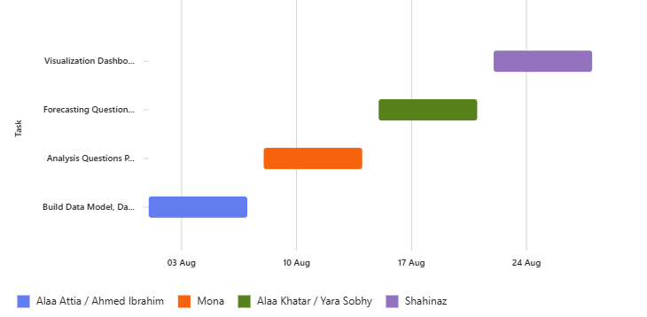
Project Timeline - Gantt Chart
Visualization Dashboard
Forecasting Questions Phase
Analysis Questions Phase
Build Data Model, Data Cleaning
and Preprocessing
W1
W2
W3
W4
Alaa Attia Ahmed Ibrahim
Alaa Khatar Yara Sobhy

Slide 4
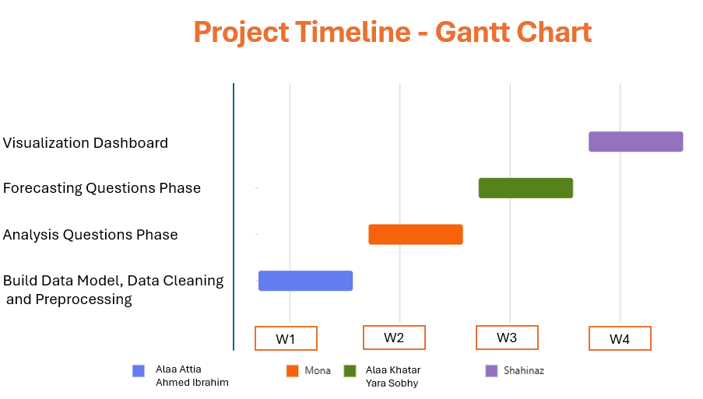

Slide 5

⚠️ Challenges team Might Face
Data Volume and Complexity: The dataset is large and includes over 40 features.
Data Cleaning: Missing values, inconsistent formats (e.g., timestamps, units), or outliers.
Time Series Analysis: Handling and analyzing time-based data across different time zones.
Multivariate Relationships: Understanding complex interactions between variables.
Visualization: Presenting insights clearly from a large dataset.

